Slide 1

AASC Lesson 1.4:
Threat Assessment
Notes:
Find guidance inserted in the note section of each slide.

Slide 2

Overview
2.4.2 Source of information and Intelligence
2.4.3 Enemy Intent
2.4.4 Enemy Capability
2.4.5 Enemy Opportunity to Use IEDs
2.4.6 Issuing a Threat Summary
2.4.1 Introduction to Threat Assessment

Slide 3
Terminal Learning Objectives
At the end of this module the participant will be able to explain the threat assessment process and interpret a threat summary.

Slide 4
2.4.1 Introduction to Threat Assessment

Slide 5
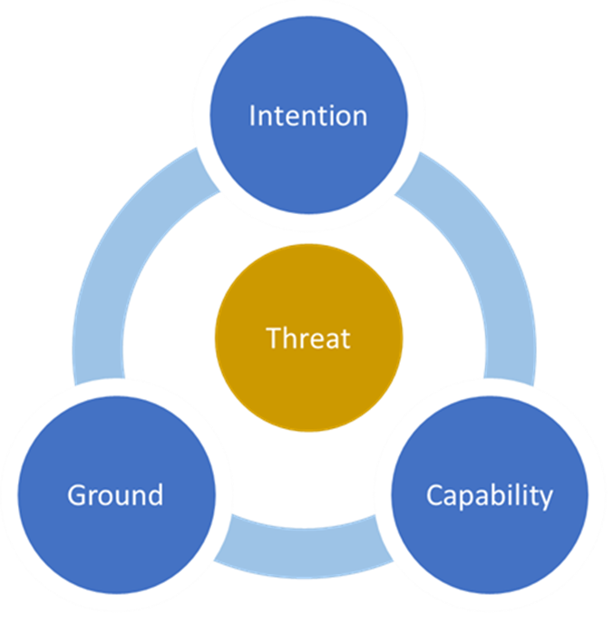
Intro to Threat Assessment
C-IED Threat Assessment is a simple process that allows us to combine intelligence with knowledge of the local environment and an understanding of an adversary to determine the most likely location, time and type of an IED attack and the driving forces behind it.
Notes:
Introduction. C-IED Threat Assessment is a relatively simple process that allows us to fuse the output Intelligence analysis with knowledge of the local environment and also knowledge of Adversary IED capability. This allows us to make an assessment of the potential IED and associated threat, during any given IED operation or operational phase. In addition to the device, we will also consider public order, IDF and SAF which could be directed against the search team while it is carrying out its task.
The process is based on operational experience gained over many years was developed by specialists involved in IEDD and High Risk Search operations. It is now part of the within the generic operational planning cycle.
C-IED Threat Assessment therefore affords commanders with an ‘IED operations specific’ planning tool of planning which will inform the wider planning cycle. The process can be conducted at any level, as relevant at Fire-Team as it is within Formation Headquarters. In the context of this course however we will focus on its application during patrol planning at the lowest tactical level.
C-IED Threat assessment can be conducted, even when presented with an extremely limited amount of information. In contrast it can also be extended into an enduring and extremely detailed process, should this be required/appropriate

Slide 6



Intro to Threat Assessment
Notes:
The concept of a threat assessment is based on the theory that for any threat to exist, there must be 3 key ingredients. These are intent, capability and ground (sometimes referred to as opportunity or, more widely, environment). Without all three components, a threat cannot exist.
[build slide]Intent. Intent is the foundational component such that for any threat to exist, a person or group must intend to cause harm. Lets use an example. Let us assume you have a long running feud with someone from your village. If your feud is relatively minor and the person with whom you have a disagreement does not wish to settle the argument with violence, you could say, s/he has no Intention to harm you and therefore there is no threat. If however, your argument is with someone who has no regard for the law and wants to inflict physical harm to you, then there is a threat.
[build slide] Capability. This refers to the tools with which an adversary or aggressor will use to inflict an attack. Taking our example further, if the person you have an argument with wishes to harm you but is physically very weak and has no weapon, you could say there is still no threat. If on the other hand the person is stronger than you or possesses a weapon such as a gun or a knife, you would say there is a threat.
[build slide] Ground. Ground refers to a place or time in which a threat actor who intends to harm you, can use their weapon (capability) to inflict damage. It is sometimes referred to as “opportunity”. Taking our example further still. Let us can assume the person who you have a feud intends you physical harm, has a weapon such as a knife, but has no means to get close to you because you are no longer in the village, then we would say there is no threat. On the other hand if the person was standing in front of you with intention and knife in hand, we would say there is a very clear threat.
Image top courtesy Dreamstime
Image right courtesy Getty Images.
Image left courtesy WikiHow.

Slide 7
Intro to Threat Assessment
Notes:
This concept of a threat assessment applies equally, regardless if it’s a threat of a knife attack from your neighbour or an IED attack by a terrorist group. Before we move to the process of conducting a threat assessment, we will discuss what sources of information can be used.

Slide 8
2.4.2 Source of Information and Intelligence

Slide 9
Sources of Information and Intelligence
Intention
Intelligence Reports
J2/S2 Cell
Engagement
Capability
Historical data
Recent incident reports
IED trends
EOD Cell
Military Maps
Open source maps – Google
Patrol traces
Hotspot Maps
Human Terrain Analysis
Ground
Notes:
To understand the intention of an adversary, we must look to the available intelligence. Our first point of contact will be the J2/S2 Intelligence Cell. We can also look at old situation and incident reports to determine who the adversary was targeting and what they were trying to achieve. Other sources of information could be the engagement platoon or open source intelligence reports.
Adversaries are human and, like the rest of us, form habits. Where an IED has been used successfully, they often try to repeat the same tactics. This means we use historical data to make an assessment of what an adversary may do in the future. There are a number of sources to gather this information: IED incident reports, Significant Activity reports, daily SITREPs or routine IED trend reports. If you are able to communicate with the EOD cell, they will be able to support you in this area.
In our next lesson, we will discuss Vulnerable Points and Vulnerable Areas, which are places which offer an adversary an opportunity to employ an attack. Identifying VP/VA is a an output of the threat assessment and critically relies on a thorough understanding of the ground and environment.
Maps are the most important source of information for conducting analysis. These can either be military or civilian, hard copy or digital. Online platforms such as Google maps offer readily available and detailed open source information.
Another key source of information is patrol traces. These are maps which show where all the recent patrols have been, this allows us to identify areas which we routinely use and have therefore become targetable (setting patterns).
The final source of information is through Human Terrain Analysis.
This is a summary of the attitudes and behaviors of the local population. It will help us understand which areas are Permissive, Semi-Permissive and Non-Permissive which allow us to understand how the locals populace will interact with the adversary. This information can be sources through the S2 cell or through the engagement platoon.

Slide 10
2.4.3 Aggressor Intent

Slide 11
Aggressor Intent

Slide 12
Aggressor Intent
Build our understanding of the aggressor to determine the likelihood and type of attack.
Who is the enemy or adversary?
What are they trying to achieve?
Who are they targeting?
Notes:
Now that we have identified the different sources of information, we can now begin to build our understanding of the aggressor. Understanding the adversary intent, will help us determine the likelihood and type of attack. This is done by essentially answering three questions:
Who is the aggressor?
What are they trying to achieve?
Who are they targeting, and who are they not targeting?

Slide 13
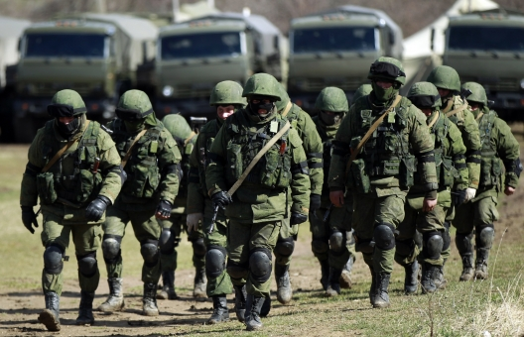
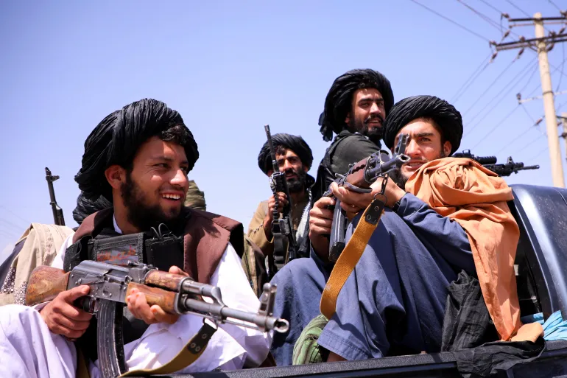
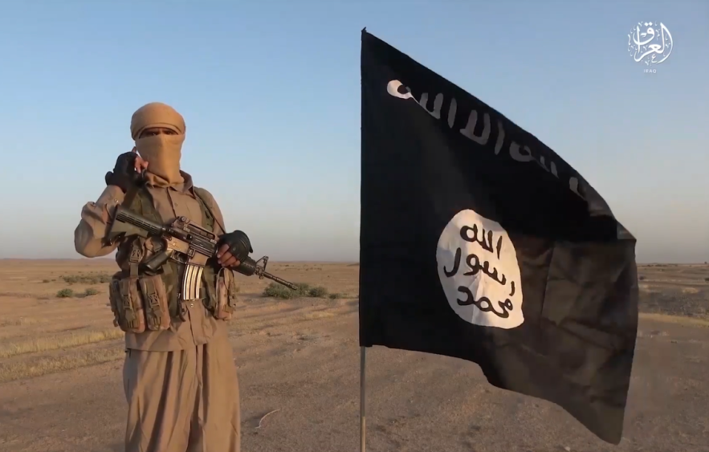
Aggressor Intent
Who is the enemy?
Professional
Opportunist
Fundamentalist
Notes:
Understanding what kind of adversary we are facing will help us to shape our understanding what intentions they may have.
Professional:
The professional is likely to use in-service weapons and weapon platforms in an efficient and directed way, most probably in the manner for which these weapons were originally designed. Attacks may be controlled and co-ordinated at a higher level as part of a campaign.
Opportunist:
The opportunist may exploit a transient opportunity to attack. This may occur when a weapon or a means of attack becomes available or when a force exposes a weakness. Such an adversary may use novel tactics with conventional weapons.
Fundamentalist:
The fundamentalist is motivated by religious or ideological aims. Attacks are characterized by scant regard for self-preservation or the lives of others, including non-combatants: suicide attacks are the most extreme example.
Image left – “little green men” during the invasion of Ukraine 2014, courtesy Reuters News Agency
Image right – Islamic State Propaganda
Image left – Taliban fighters, courtesy Reuters News Agency

Slide 14
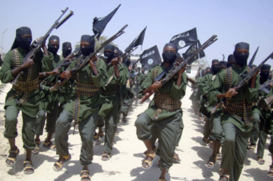
Aggressor Intent
What is the enemy trying to achieve?
What is the adversary stated goals? (At a macro and local level)
What is their attitude towards us as a peacekeeping force?
What have they been trying to achieve to date?
Notes:
This question is Intelligence focused. Current and recent Intelligence Reports will provide us with detail of recent IED attacks and also an assessment of likely future attack scenarios. We should consider what the adversary is trying to achieve both locally and at the country level. We should consider the insurgent attitude towards us as a peacekeeping force. Finally, we can look at what the group has historically tried to achieve as a predictor of future actions.

Slide 15
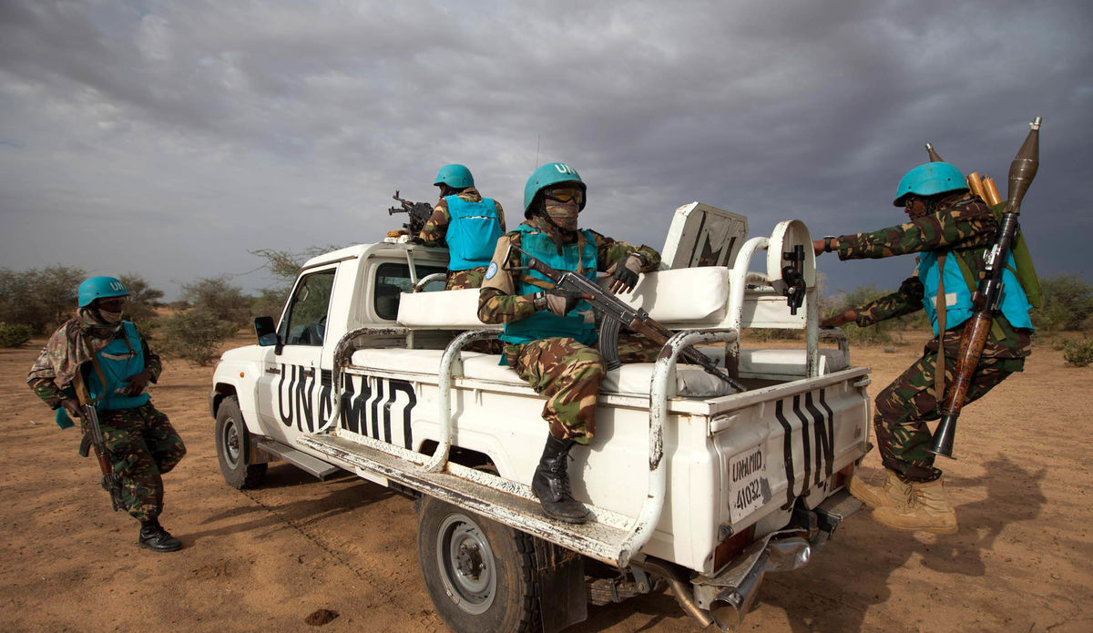
Aggressor Intent
Who is the enemy targeting?
Friendly forces?
Foot patrols
Mounted patrols
Logistic convoy
Attacks on FOBs
Attacks on targetable patterns
Attacks on follow up agencies (come on attack)
Infrastructure?
Other armed groups?
Civilians? Or specific civilian group?
Government institution or process
Notes:
If the answers to the previous questions indicate a threat we now ask Who is the adversary targeting? We can best assess this by looking at who they have targeted before.
Have they targeted Friendly forces?
Do they target foot patrols or have they been targeting mounted patrols?
Are logistic convoys targeted, and do they target specific vehicle in the convoy?
Do they conduct attacks on FOBs?
Are our actions creating targetable patterns?
Has Infrastructure been targeted? Such as phone masts, bridges or railway lines.
Are there other armed groups who are also targeted?
Do the aggressors target Civilians? Or do they target a specific civilian group?
Do they Government institutions such as government offices or local security forces. Do they target government processes such as local elections.

Slide 16
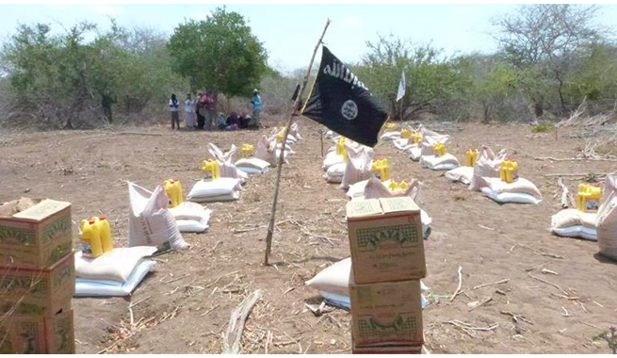
Aggressor Intent
The Local Population
Notes:
It is important to understand how the adversary is trying to influence the local population. Each conflict, and each region in a conflict will have different dynamics between the local civilians and an aggressor. Understanding this dynamic will help us determine the likelihood of an aggressor employing IEDs and help us determine what type of IED is likely to be employed. For example. In an area where an insurgent group is trying to win support with the local population, they are less likely to employ VOIEDs at the risk of harming civilians. If they were to employ VOIEDs they would likely warn the civilians so we may see an increase use in warning markers or a change in civilian pattern of life. If the insurgent group had no care for the civilian population, they may have more freedoms in the types of IEDs they employ.
Looking at the picture you can see an example of Al-Shabab providing aid to local communities whist trying to promote themselves. They are clearly trying to win the hearts and minds of the locals. In this case they may choose to employ IEDs in a way that doesn’t affect the locals.
Photo – Al-Shabab propaganda.

Slide 17
2.4.4 Aggressor Capability

Slide 18
Capability
What type of device will the aggressor try to use and how will it be initiated?
Notes:
Now that we have tried to identify who the aggressor is trying to target, we now need to consider what capability they have to carry out an attack. This is done by essentially answering the questions: What type of device will they try to use and how will it be initiated? We can answer this by considering:
What has the aggressor already successfully used?
What are they capable of using; i.e. how advanced are their ability to make IEDs?
What resources do they have access to?
Are they concerned by civilian casualties?

Slide 19
Aggressor Capability
Consider Type of Device and Means of Initiation:
  Time IED
  Command IED
  Victim Operated IED
What has the aggressor successfully used?
What does the aggressor have access to (are they externally supported, well funded, well trained etc)?
Remember your key sources of information.
Friendly force activity will also determine what type of attack is most likely to be employed (IED, but also consider how SAF, public disorder, IDF may be used to initiate a come on or provide a multi-layered effect on the target or responders).
Notes:
When considering the aggressor capability we are essentially considering what Type of Device and Means of Initiation ie Time, Command or Victim operated (VO) IEDs.
The adversary will often use tactics that have been successful in the past so we can look at previous events. Remember the key sources of information are:
Historical data
Recent incident reports
IED trends
EOD Cell
Determining the type of IED that the adversary will employ is also determined by our own activity. Do not forget to consider how SAF, public disorder, IDF may be used to initiate a come on or provide a multi-layered effect on the target or responders). There have numerous examples of complex attacks worldwide where one attack or incident is used to tee up another on a secondary target or to inflict more damage on the primary target. Discuss examples with the class.

Slide 20
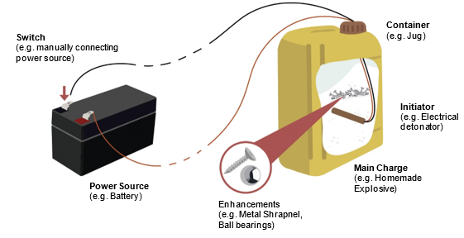
Aggressor Capability
Command IEDs
Favourable for targetable patterns in space and time.
Able to attack specific targets and avoid others.
Require favourable terrain.
Considerations:
Are you presenting frequent and trackable targets
Think of your posture – are you high profile and fairly inflexible in the routes you use?
Notes:
Command IEDs are often used when we are presenting a targetable pattern in both time and space. Command IEDs also offer the adversary the opportunity to attack specific targets, while ensuring others are avoided. Command IEDs do however need favourable terrain for both attack and extraction of the triggerman.
Are you presenting frequent and trackable targets (either mobile, on foot or static targets) that EF can easily engage with command IEDs. Think of your posture – are you high profile and fairly inflexible in the routes you use? Consider the Command IED attack options, in line with EF capability, intent and resources.

Slide 21
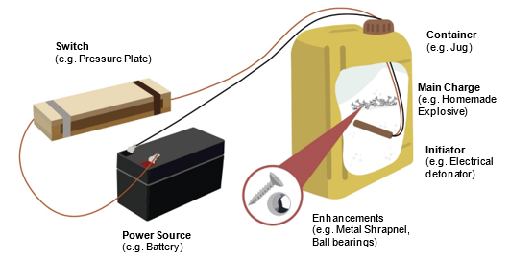
Aggressor Capability
VO IEDs
Favourable for targetable patterns in space but not time.
Indiscriminate
Require favourable terrain.
Considerations:
Are you setting patterns on patrols?
What is the aggressor attitude towards civilians
Has civilian pattern of life changes
Notes:
Victim-operated improvised explosive devices (VOIEDs) are used when the activity of an intended target is more predictable in space rather than in time and therefore the use of a time delay is inappropriate. An adversary must carefully select the location for VOIEDs if unintentional third party initiation is to be avoided.

Slide 22
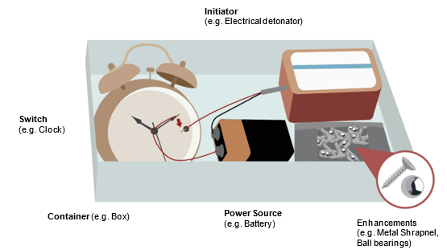
Aggressor Capability
Time IEDs
Favourable for targetable patterns in space and very specific time.
Indiscriminate
Aggressor loses control once deployed.
Considerations:
Does your daily routine afford the use of an IED attack?
Does your base have poor security procedures?
Who has access?
Notes:
Time operated improvised explosive devices (VOIEDs) are used when the activity of an intended target highly predictable in space and in time. These devices are best employed when the aggressor can exploit poor security procedures such as access or lack of observation. Remember that when a timed IED is employed the aggressor loses control of the device and so it can be indiscriminate.

Slide 23
2.4.5 Aggressor Opportunity (Environment – human and physical terrain)

Slide 24
Aggressor Opportunity
Where will the device be located and when will it be employed?
How will the enemy employ the ground to achieve best effect.
Identification of Vulnerable Points and Vulnerable Areas (next lesson)
Notes:
Having developed an assessment of how aggressors intend to employ IEDs and also what type of IED/s they are most likely to use, we now ask: “Where will the device be located, and when will be employed?”
Different types of devices are used to achieve different types of attack and will lead to a different use of the ground.
The output will be a list of geographical locations where you have identified an increased likelihood of IED Attack. These locations can now be listed and plotted as Vulnerable Points (VPs) and Vulnerable Areas (VAs). We will look at these in detail in the next lesson.

Slide 25
2.4.6 Issuing a Threat Assessment Summary

Slide 26
Threat Summary
Threat Assessment is the consolidated answer to the following questions:
Who is the aggressor?
What are they trying to achieve?
Who are they targeting?
What type of device will the aggressor try to use and how will it be initiated?
Where will the device be located and when will it be employed?
Notes:
A threat assessment is the product of answering a series questions to determine intention, capability and opportunity. These questions can be simplified into:
Who is the aggressor?
What are they trying to achieve?
Who are they targeting?
What type of device will the aggressor try to use and how will it be initiated?
Where will the device be located and when will it be employed?
It is important to note that these questions are a simplification of a significant amount of analysis, staff time and products.
The narrative of answering these questions can be described as a Threat Assessment Summary.

Slide 27
Threat Summary
A Threat Assessment Summary is a narrative summary of the answer to the questions.
It is a simplified summary of the threat assessment that can be understood at all levels of command.
Notes:
The narrative of answering these questions can be described as a Threat Assessment Summary.
As previously mentioned, the threat assessment will developed following as much analysis as time and resources allow. The threat summary provides a simple narrative that can be understood and applied at all levels of command to enable those mitigation measures to be applied.
Where possible, the threat assessment summary is complimented by maps to highlight areas of high and low threat.

Slide 28
Threat Summary
Who are the aggressor: An IED cell from the Combattants Indépendants du Sud Carana (CISC).
Who are they targeting: Local security forces but also willing to target UNAC patrols.
What is their intended outcome: Reduce the local security force patrols to give the CISC better freedom of movement.
What is being used: They are capable of using all types of IED but they prefer to use command IEDs to avoid civilian casualties.
Where will they be targeted: Generally on VPs where there is significant slow down points with good lines of sight and opportunity extract.
When will they be targeted: During local security force patrols.
Notes:
This is an example of an over simplified example of a threat assessment summary.

Slide 29
Threat Summary
  The most likely threat is from the local CISC group seeking to gain freedom of movement by deterring UNAC and local security force activity in the area of GALESI so they can strengthen their hold and consolidate their support base within the local population.
  They likely to use CW IED to bypass ECM to target soft skinned logistics convoys, often following up with small arms fire. They will also attack UNAC convoys in the same way if the opportunity presents itself, and they can extract without becoming decisively engaged before blending into the local population.
  IEDs are likely to be laid at vulnerable points on the rural/urban interface and the firing point or lookouts will have line of sight to the target from built up areas.
Notes:
This is another example of a threat assessment summary. If you were given this as a commander, would you be able to use it to reduce the threat from IEDs during patrols?

Slide 30
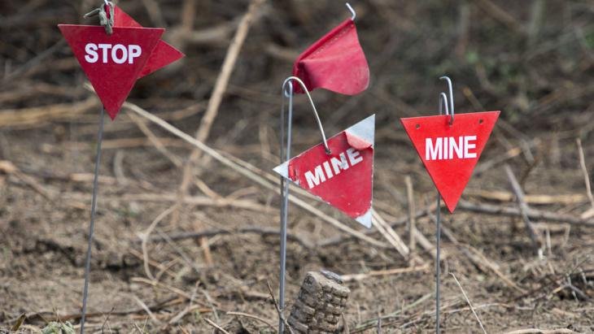

Questions?

